Slide 1
CS 4530: Fundamentals of Software Engineering Module 16: Coding With AI Agents
Adeel Bhutta, Rob Simmons, and Mitch Wand
Khoury College of Computer Sciences
© 2026 Released under the CC BY-SA license

Slide 2
This Is Just the Beginning of Our Conversation
This topic is unlike anything covered so far:
The technology is evolving faster than any textbook (or lecture!) can capture
There is genuine disagreement among experts about best practices
Your professors are learning alongside you, modeling the best practices we teach

Slide 3
Outline
What is an LLM? What is an AI Coding Assistant? Why is context so important?
A 4-Step Pattern for Human-AI Workflow
Prompt
Plan
Engage & Evaluate
Finalize & Document
A Few Words about AI traps

Slide 4
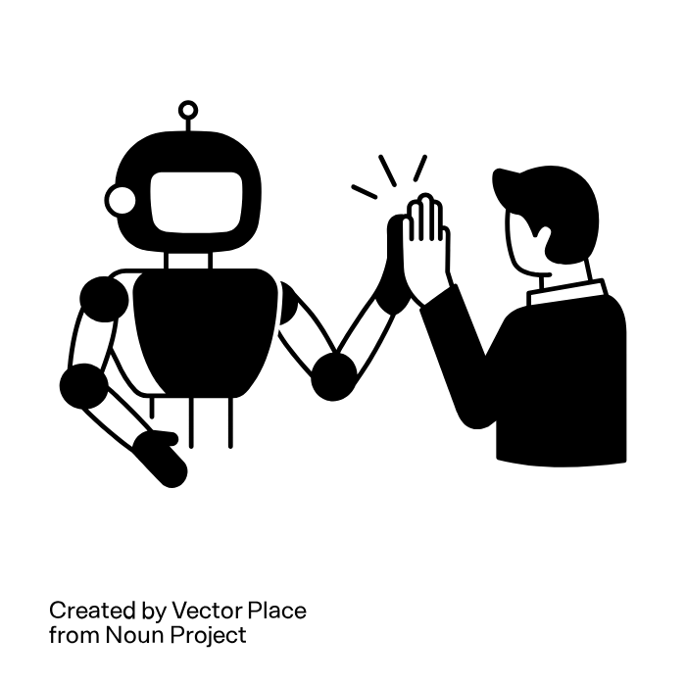
Our Slogan:
AI amplifies human capabilities; it doesn't replace them
https://thenounproject.com/browse/icons/term/ai-collaboration (CC BY 3.0)

Slide 5
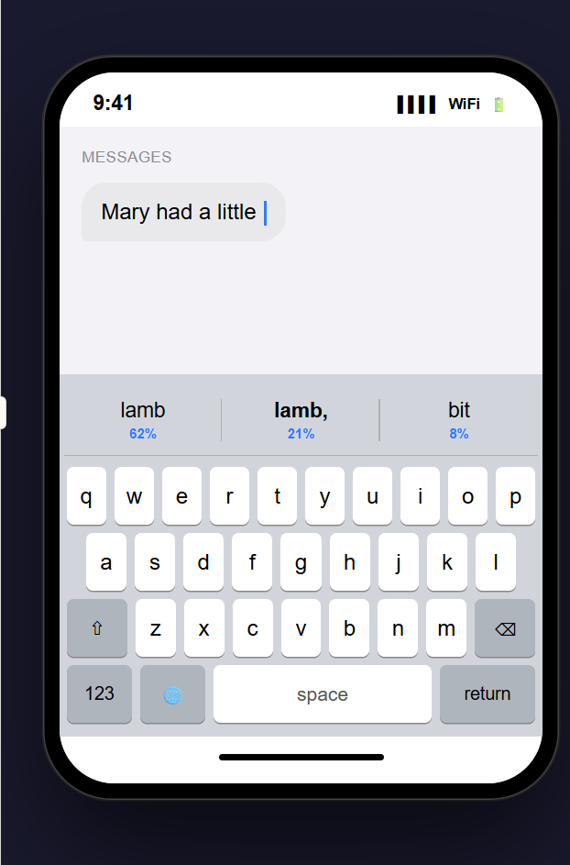
What is a Large Language Model (LLM?)
Basically, it is an overgrown autocomplete.
Given a large database of texts and an initial segment of your input, it answers the question:
What is the most likely way in which this input would continue?
More accurately: it produces a probability distribution of likely continuations, and draws from that distribution (hence non-deterministic)
Notes:
Here the autocorrect shows its guess about the next word <click> Observe that it has also assigned probabilities to each of the alternatives.

Slide 6
Why this matters
Explains hallucination: model predicts plausible-looking text, not necessarily true text
Explains why context matters: predictions depend on what came before
Explains strengths: patterns in code are highly predictable!

Slide 7
What is an AI Coding Assistant?
An AI coding assistant typically consists of an LLM
trained on a large base of running code
operating in a loop with an IDE
it can add artifacts inside the IDE to its context
it can operate on your code (with your permission)

Slide 8
AI Coding Assistants: Strengths
Strengths:
Pattern recognition: recognizes and reproduces common coding patterns across millions of codebases
Syntax knowledge: extensive knowledge of languages, libraries, and frameworks
Integration with IDE can guide search
Cross-domain transfer: can apply patterns from one language to another
Rapid prototyping: generates boilerplate, tests, and common implementations quickly
AI in-the-loop: can run tests and evaluate the results
did it work? if not it can try something else

Slide 9
AI Coding Assistants: Limitations
Limitations:
Limited Context: can only see 100K-1M tokens at once — may miss parts of large codebases
Generates code based on patterns, not execution results
Hallucination: may generate plausible-looking code that doesn’t actually work, or doesn't satisfy your project constraints.
Think of it as a well-read junior developer who has seen millions of codebases — but has never run your specific project.

Slide 10
But An LLM Can't Find Everything
What tools can auto-find: related files, type definitions, call graphs, similar patterns, test files
What tools cannot auto-find: why a design was chosen, undocumented requirements, knowledge in your head
And of course, the LLM can't figure out your intent.

Slide 11
A 4-Step Workflow for Human-AI Interaction
Prompt
Give the AI the context it needs to do its job
Plan
Have the AI create a plan for what you want it to do
Review the plan
Review the review
Engage & Evaluate
Engage with AI to guide to the desired result
Evaluate the results
Finalize & Document
Make a record of design decisions to benefit future teams.
Notes:
This gets us to our second item in our outline: a 4-step workflow that distills a best-practice for using a coding assistant on your project.
<Read Slide>
We will spend most of the rest of the lecture walking through this workflow.
Remember that this is an idealized process-- in practice these steps will likely overlap and blend into each other.

Slide 12
A 4-Step Workflow for Human-AI Interaction
Prompt
Give the AI the context it needs to do its job
Plan
Have the AI create a plan for what you want it to do
Review the plan
Review the review
Engage & Evaluate
Engage with AI to guide to the desired result
Evaluate the results
Finalize & Document
Make a record of design decisions to benefit future teams.
Notes:
Step 1: Prompt.

Slide 13
Prompt: Give the AI the context it needs to do its job
What are the domain concepts?
What is the goal?
What kind of output do we want?
What restrictions to we need to place on the AI?

Slide 14
Prompts can have different scopes
Project-level prompts
for use throughout the project
project constraints (guardrails)
project architecture
Task-level prompts
describe specific pieces of the project
describe constraints & architecture specific to this task

Slide 15
Project Constraint Prompts
These are your guardrails
## Software Stack
- Frontend: Next.js 14+ App Router, TypeScript strict
- Backend: Convex for real-time data, Supabase for auth + storage
- Auth: Clerk (never roll custom auth, we are not animals)
- Styling: Tailwind only — no CSS modules, no styled-components
## Hard Rules
- Never install a new dependency without asking first
- Never modify the database schema without showing the migration plan
- All API calls go through Convex functions, never direct Supabase
client calls from components
- Environment variables go in .env.local, never hardcoded
(I will find you and I will revert you)
# FAILURE CONDITIONS:
- Any component exceeds 150 lines
- Fetches data client-side when it could be server-side
- Uses any UI library besides Tailwind utility classes
- Missing loading and error states
- Missing TypeScript types on any function parameter
Notes:
Of course, this pattern applies to other agents as well.

Slide 16
Architecture Constraint Prompts
## Repository Structure
- `src/` for source code
- `additionService.ts` for business logic
- `additionController.ts` for handling requests
- `*.test.ts` for tests
- `scratchpad.ts` for experimental code
- `express.ts` for express app setup
- - `src/server.ts` to start the application
`package.json` for dependencies and scripts
## Patterns
- Use server components by default, client components only when
interactivity is required
- Error boundaries on every route segment
- Zod validation on every user input
Autogenerated README.md files can be a good basis for this portion of the prompt
Notes:
(These are from two different projects). Many of our repos have exhaustive README's. (Prof. Wand says: some of them are very good, others not so good, I(HIS)HO.) I.f you guess they were generated by AI from the codebase, you are probably right. But if you use one of them, make sure it reflects what YOU want in YOUR project.

Slide 17
Task Prompts
These are the cues for specific tasks within your project
Carefully craft these in advance
Most AIs will let you save these for reuse
You can invoke them in chat or in scripts

Slide 18
Task Prompts should have testable Success and Failure Criteria
Write prompts like like legal contracts, with four enforceable sections:
Goal — a list of testable criteria (COS?!)
Output Format — the specific structure you expect.
Constraints — hard boundaries that can’t be crossed.
Failure Conditions — what makes the output unacceptable.
include these if they are different from project-wide criteria
Notes:
This makes "When you're done" readable to your AI.

Slide 19
Task Prompt: Goal
# Goal (Bad) Add a subscription system to the app
- Add a subscription system to the app
# Goal (Better) Implement Stripe subscription management
## Success
- a user can subscribe to one of 3 tiers (free/pro/team)
- a user can upgrade/downgrade instantly
- a user can see billing status on /settings/billings
- a free user can subscribe to Pro,
- see the charge on Stripe dashboard
- access gated features within 5 seconds.
The difference is testability -- each of these can be independently tested.
Notes:
The author (Phil Rentier) writes: "[the original prompt] is the prompt equivalent of telling your GPS “take me somewhere nice.” You’ll end up somewhere. It might be a Michelin star restaurant. It might be a gas station in Ohio.
Notice the user-story/COS framework here.

Slide 20
Task Prompt: Format
What you want delivered, and how you want it delivered
Tell it what to hand you
Bad:
Better:
Create an API endpoint for user onboarding
# FORMAT:
1. Convex function in convex/users.ts (mutation, not action)
2. Zod schema for input validation in convex/schemas/onboarding.ts
3. TypeScript types exported from convex/types/user.ts
4. Include JSDoc on the public function
5. Return { success: boolean, userId: string, error?: string }

Slide 21
How much prompting you need to provide depends on three things:
Your understanding: Experts know exactly what context matters; novices may not know what to include. You can only identify relevant context for things you understand.
Model capabilities: Frontier models infer much more from less. GPT-3.5 needed explicit instructions; Claude Opus can often infer intent.
Tool capabilities: Basic Copilot sees only your open files. Cursor and Claude Code index your entire codebase and find files automatically.
When all three are HIGH: just describe intent — the system figures out context. When any is LOW: you must compensate manually

Slide 22
Prompting Myths That Don’t Actually Help
Myth: Persona prompts improve output
“You are a brilliant 10x engineer...” — Models don’t roleplay
Myth: Politeness affects performance
“Please” and “Thank you” — Won’t affect the model, but polite communication is a good habit for talking to humans!
better code. Context and specificity matter, not flattery.
What actually helps:
Relevant Context
Specific Requirements
Concrete examples
Clear success criteria
Notes:
Here are a few of many myths you might see…

Slide 23
A 4-Step Workflow for Human-AI Interaction
Prompt
Give the AI the context it needs to do its job
Plan
Have the AI create a plan for what you want it to do
Review the plan
Review the review
Engage & Evaluate
Engage with AI to guide it to the desired result
Evaluate the results
Finalize & Document
Make a record of design decisions to benefit future teams.
Notes:
That's all we have to say about prompting. Let's move on to Step 2: Plan

Slide 24
Step 2: Generate a plan first.
Have the AI generate a plan first; generate code only after plan passes review.
A plan has a small evaluation surface (easier to review)
Expert says: “Wait, we should use sessions not JWT for this use case”
a plan exposes architectural issues early.
Learner says: “I don’t know what JWT is — I should learn that before approving!”
a plan reveals knowledge gaps.
Cost to fix at this stage: LOW
If you can’t evaluate the plan, you can’t evaluate the code. Plans reveal knowledge gaps early.
Most AIs have a "plan mode" to facilitate this

Slide 25
The plan is your blueprint
Eventually, you will want to check that the generated code matches the blueprint
So you will need to know how to evaluate the blueprint!

Slide 26
Remember that you need a definition of done.
Whether waterfall or agile, you need to know what “done” means BEFORE you start each piece of work.
Without a definition of done:
“Make it better” — but better how? Better for whom?
Endless tweaking with no exit condition
“I’ll know it when I see it” rarely works in practice
With a definition of done:
Clear success criteria BEFORE you start prompting (or coding)
Each output can be checked against the criteria
The plan you approved in Plan Mode IS your definition of done
Remember: user stories, conditions of satisfaction, etc.
Notes:
/currently hidden/…

Slide 27
If you can't evaluate the AI output, maybe you shouldn't be using so much AI (Just sayin')
Easy to evaluate — use AI freely:
Does the script run? Does it compile? Does the test pass? (binary yes/no — verify immediately)
Hard to evaluate — use AI carefully:
Does the quiz have confusing questions? → Give it to 100 students and find out
Is this architecture scalable? → Wait 6 months in production
Will users find this intuitive? → Ship and measure
AI can help you GENERATE for any task. But for hard-to-evaluate outcomes, don’t rely on AI to EVALUATE — you need external validation: user testing, expert review, time in production.
Notes:
This is a good point to reconsider whether AI is the right tool for the job.

Slide 28
When should I use AI? Task familiarity determines appropriateness
Use AI when: You have sufficient domain knowledge to evaluate outputs
Avoid AI when: You lack the expertise to assess correctness and quality
Learning consideration: Using AI without foundational knowledge can lead to deskilling

Slide 29
A 4-Step Workflow for Human-AI Interaction
Prompt
Give the AI the context it needs to do its job
Plan
Have the AI create a plan for what you want it to do
Review the plan
Review the review
Engage & Evaluate
Engage with AI to guide it to the desired result
Evaluate the results
Finalize & Document
Make a record of design decisions to benefit future teams.
Notes:
Moving on to Step 3, where will have the AI actually generate some code.

Slide 30
Step 3: Engage & Evaluate
Calibrate: Steer AI toward desired outcomes through feedback
Example: “That’s close, but use interfaces instead of abstract classes”
This is a conversation — you may calibrate 3–4 times per task. This is normal.
Tweak: Manually refine AI-generated artifacts
Naming, edge cases, comments, style adjustments. AI output is rarely perfect — this is expected.
Notes:
<read slide>
Let's look at these in a little more detail.

Slide 31
Calibration and Tweaking
Especially applicable for non-code AI-generated artifacts
text
diagrams
slides
etc…
Notes:
Prof Wand says: Large portions of this slide deck were generated by Claude from the 3100 slides, which were in a Markdown dialect. Claude produced some slides, but they were in an entirely different design style. I then had to calibrate by giving Claude a sample of the slides we were using for this course, and Claude re-did the slides to match our style.
But the results were still far from perfect, and I spent a lot of time tweaking things-- splitting too-long bulleted lists into multiple slides, etc.
And this deck is the result of merging the Claude results with the similar slides I prepared for Fall 2025.
And also it incorporates more thinking about the subject, along with good new material I found on the web.
REMEMBER: THE HUMAN MAKES THE FINAL DECISION

Slide 32
Step 3: Evaluation
You probably need a plan to do the evaluation
Assess AI outputs against expected results utilizing domain knowledge.
Compare output against expected end results and other success criteria.

Slide 33
Step 3: Evaluation, cont'd
Review code with the plan as a checklist.
“I know what to look for because I already approved the approach.”
Remember: If you didn't evaluate the plan, you can’t evaluate the code.
Advanced usage: some of this review can be automated (with a separate, isolated AI)
But then you still have to review the review!

Slide 34
Another kind of engagement: Making sure the AI obeys the constraints
Run the AI in a sandbox, if you can
to prevent it from deleting your emails, etc.
Remind it often about the constraints, so the constraints are always in context
Manual checking (at each step!)
Automated review by a separate AI
Refer to the onboarding guide of your AI for more specific advice.
Notes:
[Not sure whether this is the appropriate content or the appropriate placement for this slide]

Slide 35
A 4-Step Workflow for Human-AI Interaction
Prompt
Give the AI the context it needs to do its job
Plan
Have the AI create a plan for what you want it to do
Review the plan
Review the review
Engage & Evaluate
Engage with AI to guide it to the desired result
Evaluate the results
Finalize & Document
Make a record of design decisions to benefit future teams.
Notes:
Finally, we get to Step 4: Finalize & Document

Slide 36
Finalizing
Before committing AI-generated code, ask yourself:
Can I justify the design decisions in this code to a colleague?
If I look at this in 6 months, will I know WHY I chose this approach?
Am I prepared to take responsibility if this code is wrong?
Would a new team member understand the design decisions?
If the answer to any of these is “no” — you are creating maintenance debt that future-you will pay.
“It worked” is not a reason. “The AI suggested it” is not a reason. Document the actual design rationale.

Slide 37
Use Design As a Way of Communicating Organization
Remember this slide from Module 08 Code Level Design?
Software systems must be comprehensible by humans
Which humans?
The other members of your team
The folks who will maintain and modify your system
Management
Your clients
and ...
You, a week from now or 6 weeks from now

Slide 38
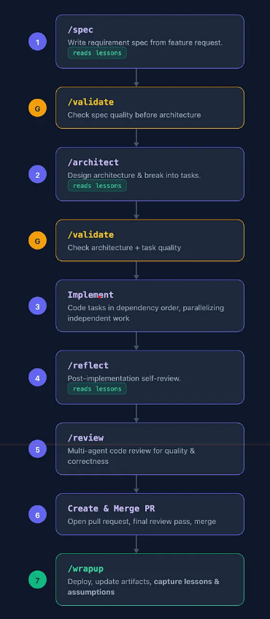
In the future: turn workflow steps into saved task prompts?
Here's an example where somebody has written out the details of the workflow steps as task prompts
Here expressed as Claude slash-commands

Slide 39
In the future: teams of agents?
So far in 2026, there have been some unhinged, heavily hyped versions of having different agents with different instructions working together. (Search for “Gas Town Yegge” at your own risk)
One of Prof Simmons’s colleagues at Lean FRO, Kim Morrison, recently demoed a less unhinged version of this idea.
Nobody at present thinks this kind of workflow produces good software engineering — software maintainable over time — but it is demonstrably better at doing certain goal-oriented complex tasks (like searching for bugs in a compiler).
Notes:
// script needs revising
ust like you have different team members with different skills, recently a lot of attention has been given to making teams of AI agents that are given specific role-playing instructions: “you’re in charge of keeping everyone on task,” “you’re in charge of reviewing PRs for frontend engineering,” “you are here to do one specific task described in this pull request and then go away forever” (Mr. Meeseeks is the appropriate Rick and Morty reference if you’re so inclined)
This is a screenshot that Prof. Simmons saw on Monday. It’s a log of a python script — written primarily with Claude — showing the workflow by which dozens of Claude agents are collaborating by filing GitHub issues and closing them with PRs, which other agents are closing.
Nobody at present thinks this kind of workflow produces good software engineering — software maintainable over time — but it is demonstrably better at doing certain goal-oriented complex tasks (like searching for bugs in a compiler).
(It can be emotionally exhausting to argue with an AI agent, but AI agents don’t experience emotional exhaustion and can yell at each other)

Slide 40
4. A few words about AI traps

Slide 41
Trap #1: The “Vibe Coding” Trap
What is “vibe coding”?
Evaluating only execution, not code. Ask AI to implement a feature. Run the app, see if it “works.” If error, describe the error to AI and repeat. Never actually read or understand the code.
Why it leads to collapse:
No troubleshooting capability — you don’t understand what the code does
Can’t provide effective feedback — you can only describe symptoms, not problems
Brittle development — one change breaks everything and you don’t know why
To effectively use AI, you must be able to evaluate the code itself — not just “does it run?”

Slide 42
Trap #2: AI Creates “Learning Debt” When Used Too Early
Path A — Learning First (recommended):
Manual coding, mistakes, understanding errors, building mental models. Slower at first.
When you eventually use AI, you can evaluate and guide it effectively.
Solid foundation that supports long-term productivity growth.
Path B — AI First:
Fast initial progress. But you never learn WHY the code works.
When complex bugs hit, you’re stuck — you can’t even describe the problem to AI effectively.
Productivity collapses and never recovers to Path A levels.

Slide 43
A "learning-tax" strategy can help mitigate deskilling.
Adopt a “learning tax” strategy: deliberately choose to implement certain components manually, even when AI could generate them instantly.
Otherwise you won't recognize when the AI is screwing up!
The goal isn’t to code without AI or to use it for everything, but to maintain the expertise that makes you irreplaceable—the judgment, creativity, and deep understanding that transforms good code into great software. (--Jon Bell)

Slide 44
Review: Our outline
What is an LLM? What is an AI Coding Assistant? Why is context so important?
A 4-Step Pattern for Human-AI Workflow
Prompt
Plan
Engage & Evaluate
Finalize & Document
A Few Words about AI traps

